Slide 1
DDS Project
Di felice Gianmarco
Lamanna Pietro
Muserra Davide

Slide 2
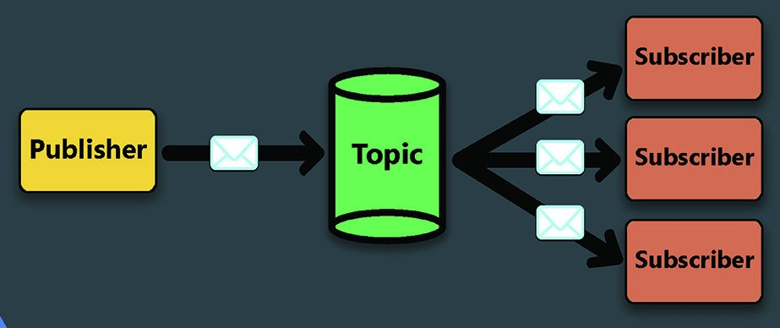
The aim of the project was to carry out a comparison and a performance evaluation of the following solutions:
ActiveMQ
RabbitMQ
Kafka

Slide 3

Supports JMS, AMQP, MQTT, and WebSocket.
Publish-subscriber messaging model
Message filtering, persistence, message priority

Slide 4

Built on top of AMQP
Support for MQTT and STOMP.
Publish-subscribe messaging model
Supports features such as message routing, message priority, and message persistence.

Slide 5

Distributed streaming platform designed for building real-time data pipelines and streaming applications.
Used to process large volumes of data in real-time.
Distributed log-based messaging model
Supports features such as fault-tolerant data replication, data retention, and data compression.

Slide 6




Key Differences
The three services differs in the following subjects:
Messaging models;
Protocol support;
Message persistence;
Data processing;
Language support;
Licensing;

Slide 7
Implementation choices
Language choices
ActiveMQ : Java
RabbitMQ : Java
Kafka : Python
Dockerized environment
Each service backbone runs in a docker container.
Automated deployment of services
Each service run through automated scripts

Slide 8
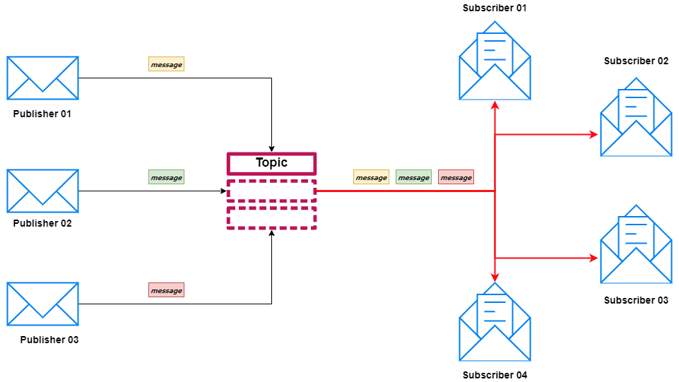

STRUCTURE
Notes:
Topic choice
Brief description about the common implementation (publisher send(), broker containerized, consumer listener);
ActiveMQ Message filtering, persistence, and message grouping are default;
Kafka flush;
RABBITMQ caratteristiche.

Slide 9

Testing System
Windows 11 Home edition;
Intel Core i7-10750H CPU; 2.60GHz 6 core - 12 logical processor);
16GB RAM;
Docker desktop v4.17.0;
Docker Engine v20.10.23;

Slide 10
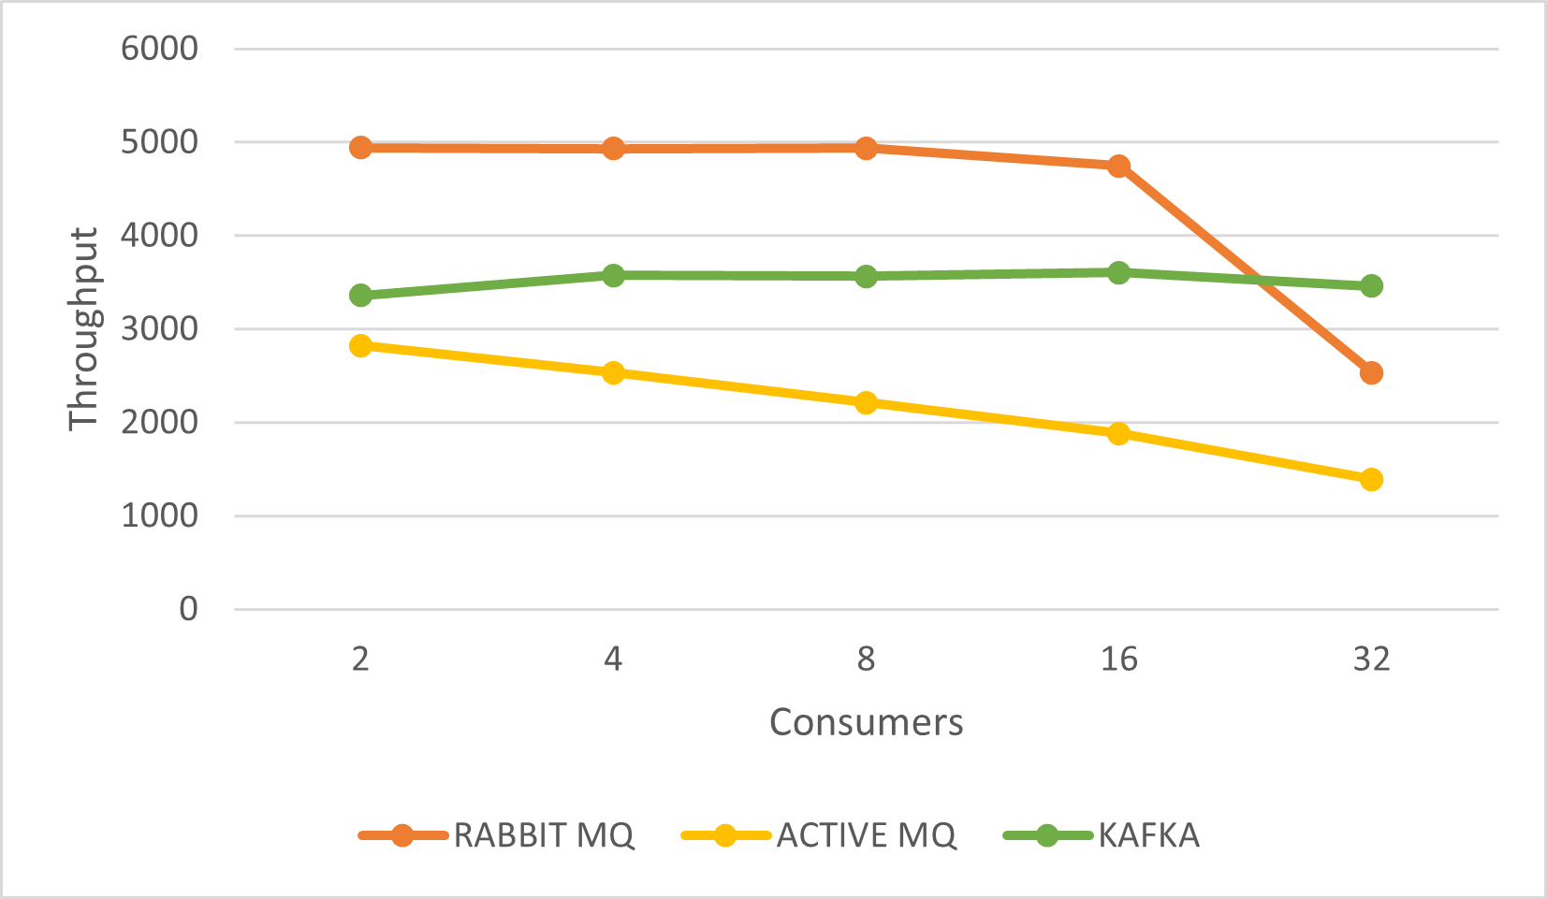
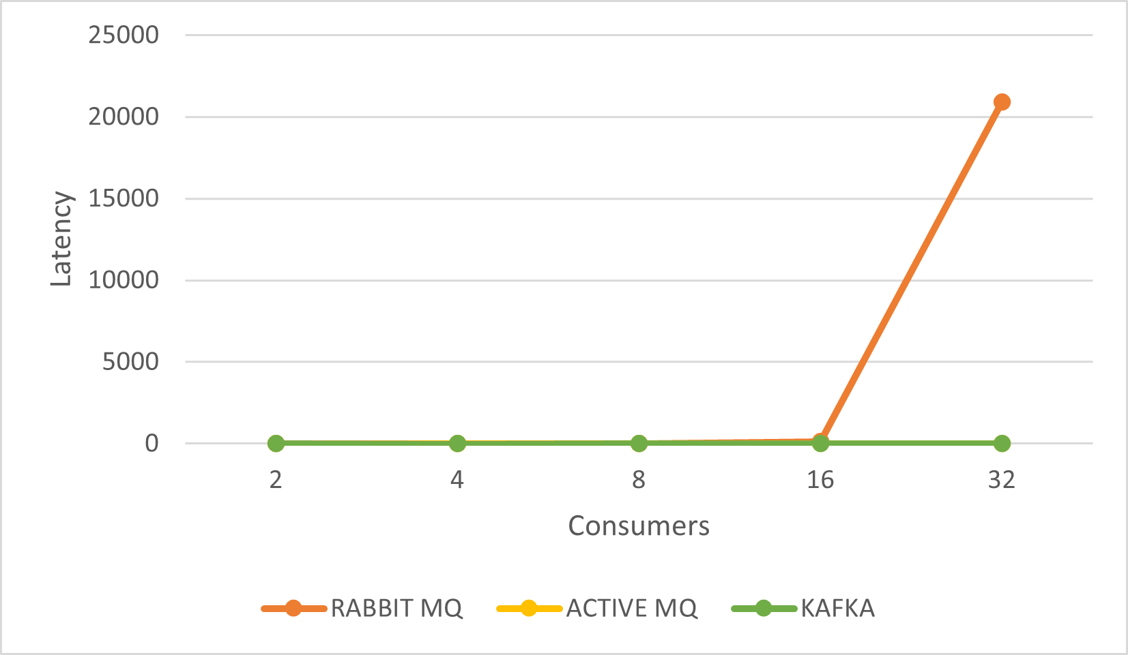
First Setting
Variable number n of consumer, 1 producer, 300000 msg, λ=5000, same topic

Slide 11
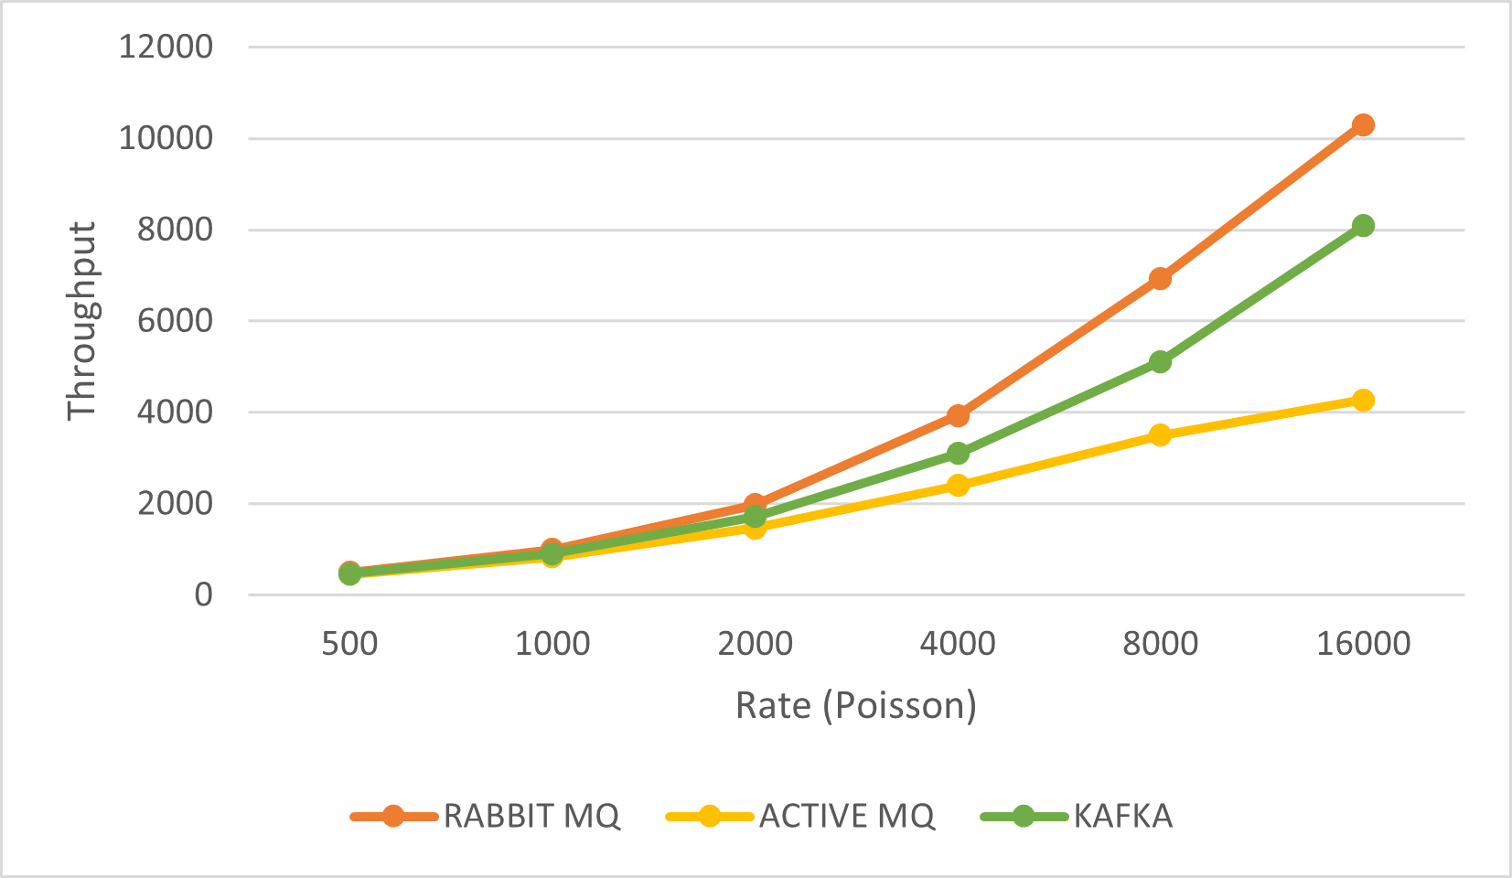
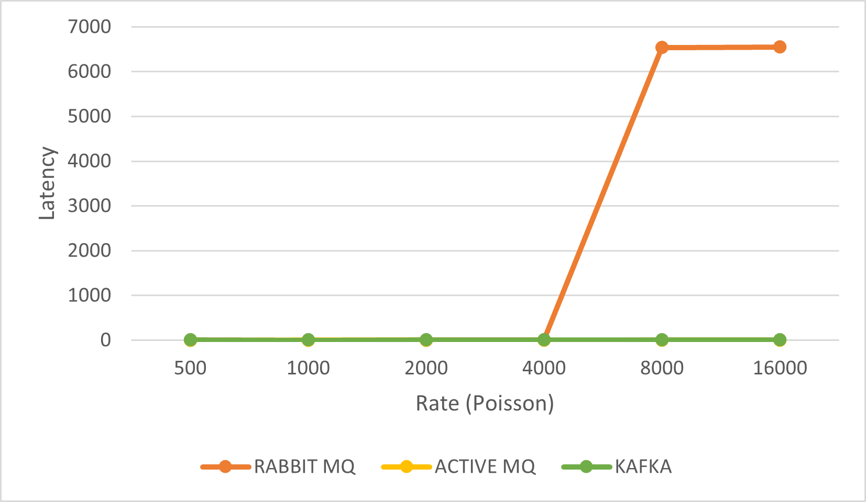
Second Setting
4 consumers, 4 producers, variable number of msg, variable λ, one topic for each pair producer-consumer

Slide 12
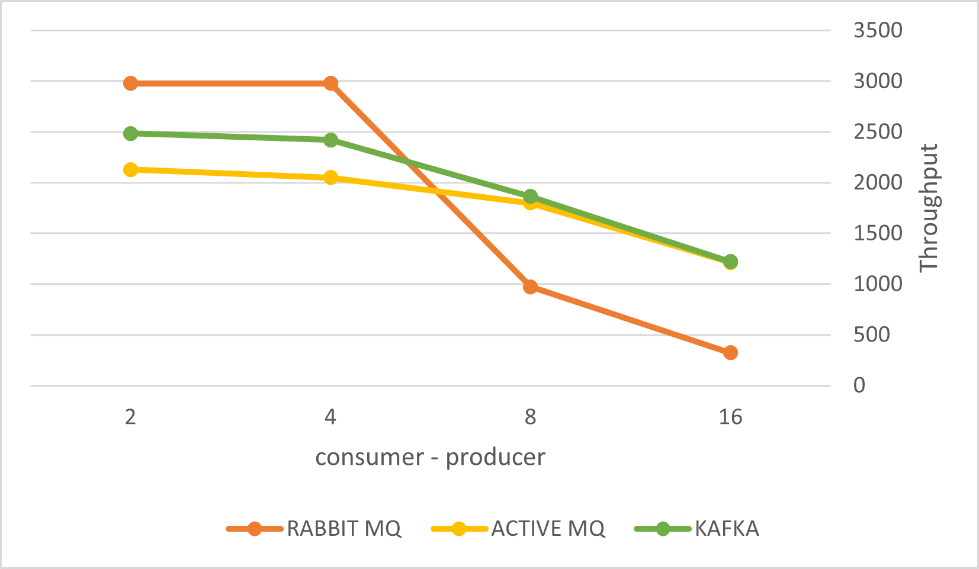
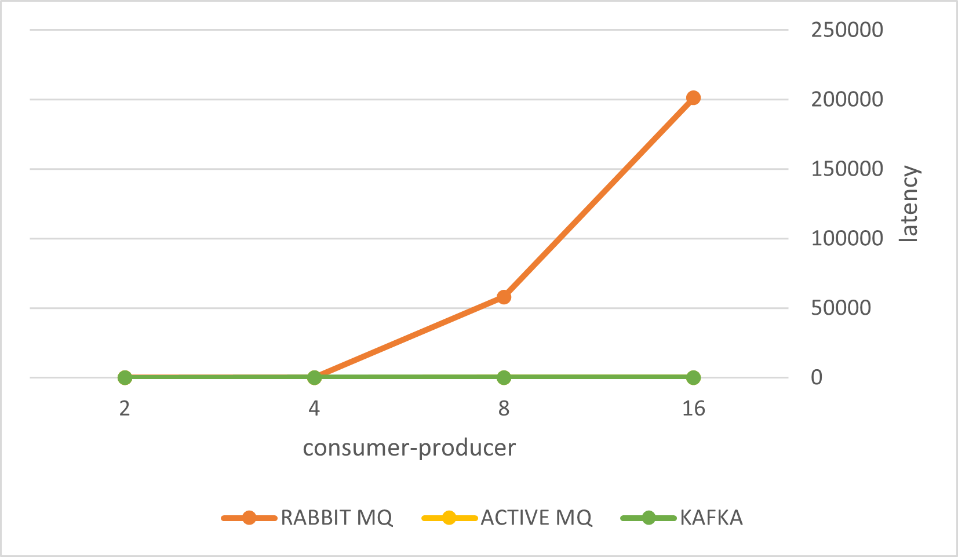
Third Setting
variable number n of consumers, variable number n of producer, 180000 msg, λ=3000;
one topic for each pair producer-consumer

Slide 13


Conclusion
RabbitMQ best solution with limited capacity system
ActiveMQ very good latency, acceptable throughput
Kafka acceptable latency, very good
throughput

Slide 14

Souce COde
Source code, installation manual and detailed report available at:
https://github.com/plamax1/DDS-Project.git

Slide 15
Thanks for the Attention!

